Slide 1

Go-to-Market Analysis for the Cab Industry
By Yawo Eklou
8/12/2023

Slide 2
Background –G2M(cab industry) case study
XYZ is a private equity firm in US. Due to remarkable growth in the Cab Industry in last few years and multiple key players in the market, it is planning for an investment in Cab industry.
Objective : Provide actionable insights to help XYZ firm in identifying the right company for making
investment.
The analysis has been divided into four parts:
• Data Understanding
• Forecasting profit and number of rides for each cab type
• Finding the most profitable Cab company
• Recommendations for investment

Slide 3
Market Overview
The cab industry has seen impressive growth, driven by changing consumer preferences and technological advancements.
The market is populated with several key players, including ride-sharing platforms. Competition is fierce, with companies striving to enhance customer experiences and operational efficiency.
This thriving industry presents a compelling investment opportunity, demanding data-driven insights to pinpoint the most promising company for investment.
Cab Industry Growth and Landscape

Slide 4
Data Understanding
Time period of data is from 31/01/2016 to 31/12/2018
Cab_Data.csv – this file includes details of transaction for 2 cab companies
Customer_ID.csv – this is a mapping table that contains a unique identifier which links the customer’s demographic details
Transaction_ID.csv – this is a mapping table that contains transaction to customer mapping and payment mode
City.csv – this file contains list of US cities, their population and number of cab users
Understanding the Data

Slide 5
Data Understanding
df_Cab_Data + df_Transaction_ID
--> df_Cab_Data_merged (1)
df_Cab_Data_merged + df_ ciy_merged
--> df_City_merged (2)
df_Customer_ID + df_Transaction_ID
--> df_Transaction_ID_merged (3)
Exploring the Provided Datasets

Slide 6
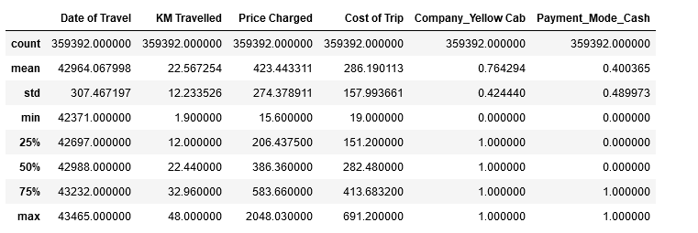
Basic Statistics

Slide 7
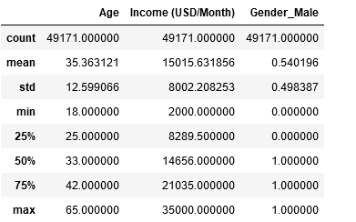
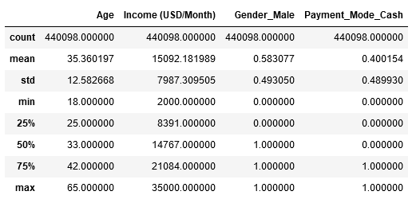
Basic Statistics

Slide 8
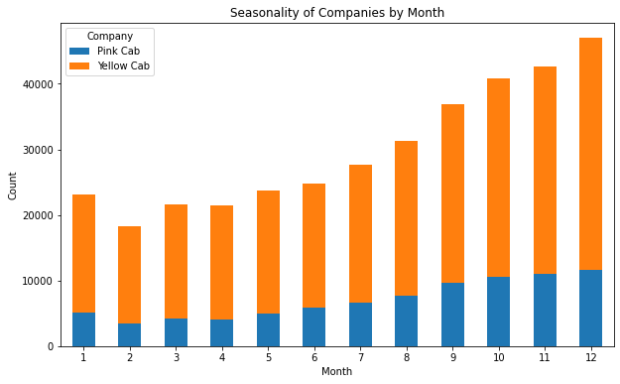
Seasonality
There is no seasonality in the demand
There is a decrease in the demand in February
The demand increases from February to December, which is the month with the highest demand

Slide 9
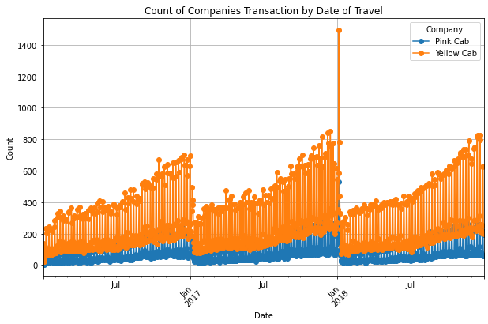
Seasonality
The variation of the monthly demand is identical (increasing) for 2016, 2017, and 2018 for both companies

Slide 10
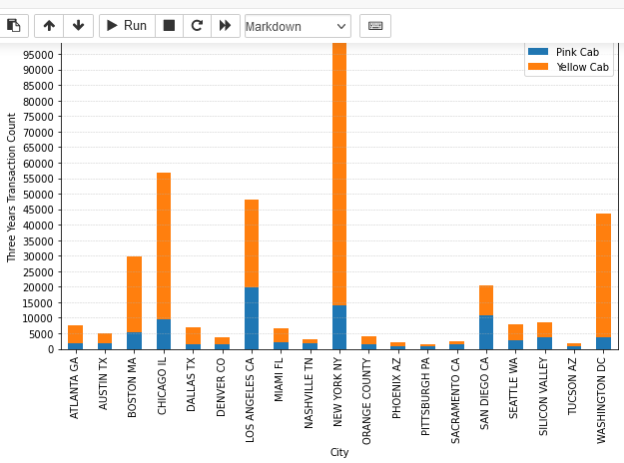
Transactions
The top three cities with higher amount of transaction by cab company are:
Yellow Cab:
New York, Chicago, and Los Angeles
Pink Cab:
Los Angeles, New York, and San Diego

Slide 11
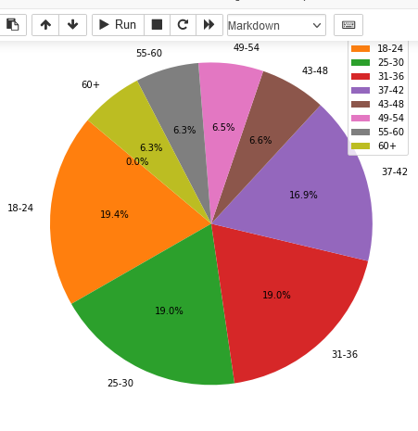
Customers Group Age
Most Cab consumer ages 18 to 36
Only few consumer belong to 43 to 60 years old group age
The highest cab consumption age group is 18 to 24, which represents 19.4% of the cab consumer population
The lower consumer age groups are 55 to 60 and 60+, representing 6.3% of the cab consumer population each

Slide 12
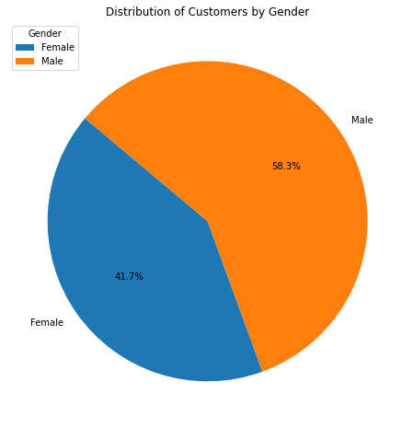
Consumer Gender Distribution
58.3% of consumers are male, which is higher than females who represent 41.7%

Slide 13
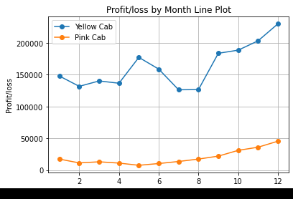
Profit and Loss
Profit/loss seasonality
Overall, Yellow Cab makes higher profit, compared to Pink Cab company throughout the year
Yellow Cab:
The profit is almost constant the first 4 months, increases in fifth month, decreases from 6th to 8th month, then increases considerably the four last months of the year for
Pink cab :
The profit is almost constant the first 5 months, then increases slightly from 5th to 12th

Slide 14
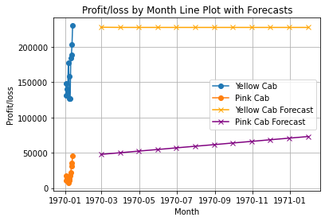
Forecasted Profit and Loss
Forecasted Profit and Loss for Each Cab Type
Yellow Cab:
The average monthly profit is expected to remain constant, around $235,000 the next year
Pink Cab:
The average monthly profit is expected to increase from $50,000 to approximately $70,000 the next year

Slide 15
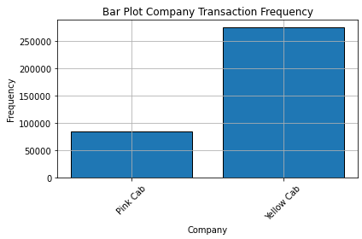
Company Transaction Count Comparison
The Yellow Cab company has recorded approximately 280,000 transactions whereas the Pink Cab has recorded 90,000 transactions within the 3 years of activity

Slide 16
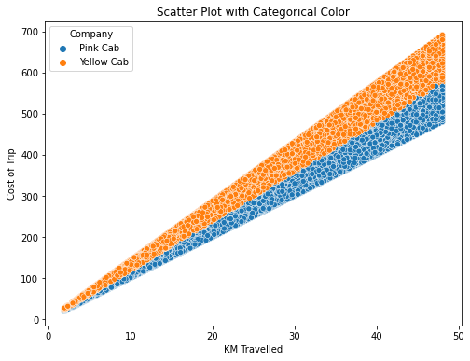
Correlation
KM Travel/ Cost of Trip
There is a strong positive correlation between the Cost of Trip and KM Travelled for both companies

Slide 17
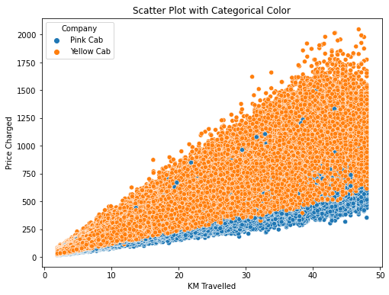
Correlation
KM Travelled/Price Charged
There is a strong positive correlation between the Cost of Trip and KM Travelled for both companies

Slide 18
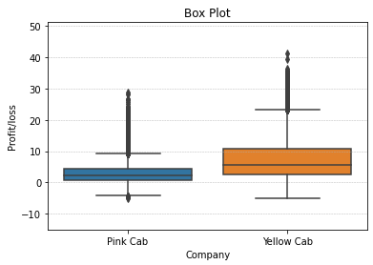
Financial Performance Summary
Yellow Cab versus Pink Cab
The median Profit per KM travelled is about $2 for Pink Cab whereas it’s about $6 for Yellow Cab
50% of profit falls between $1 to $4 per KM travelled for Pink Cab whereas it’s falls between $2.5 to $11 for Yellow Cab company

Slide 19
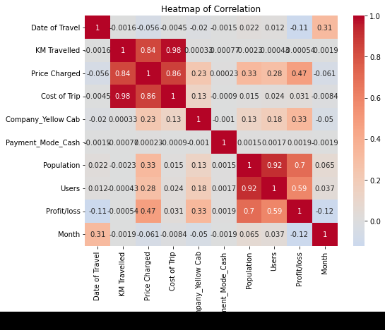
Features Correlation
Positive Correlations:
KM Travelled and Price Charged show a strong positive correlation coefficient of 0.84 as well as KM Travelled and Cost of Trip with a coefficient of 0.98, and Users and population with a correlation coefficient of 0.92
Feature Users and Profit/loss exhibit a moderate positive correlation coefficient of 0.59 as wells as Population and Profit/loss with a coefficient 0.7
Negative Correlations:
Feature Month and Feature Profit/Loss display a weaker negative correlation coefficient of -0.12.
Feature Date of Travel and Feature Profit/loss have a weaker negative correlation coefficient of -0.11.
Low or No Correlations:
All other Features have a correlation coefficient close to 0, indicating little to no linear relationship.

Slide 20
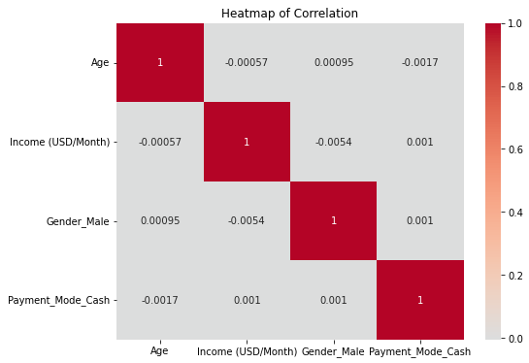
Features Correlation
Low or No Correlations
Features Age, Income, Gender and Payment Mode have a correlation coefficient close to 0, indicating little to no linear relationship.

Slide 21
Company Comparison Metrics
Profit per KM Travelled Median
One Year Forecast
Transaction Frequency
Customer Count
Metrics for Company Comparison

Slide 22
Finding the Most Profitable Cab Company
Identifying the Most Profitable Cab Company
Based on companies’ profit, Yellow Cab is more profitable than Pink Cab with a median profit per KM Travelled of $4 higher.
However, the profit/loss forecast shows that the Pink Cab profit per KM Travelled will increase the next year whereas the Yellow Cab will remain almost constant
Regardless this forecast, the Yellow Cab financially, still performs better as its profit by KM Travelled will still be higher than Pink Cab’s the following year.
This insight can potentially change in long run as the Pink Cab’s profit per KM Travelled can become higher than Yellow Cab’s according to the current forecast

Slide 23



Recommendations for Investment
Recommendations for Investment
Yellow Cab is better according to current market and metrics comparisons

Slide 24
Next Steps
Feature Selection and Engineering
Model Selection
Train and Evaluate Models
Model Optimization
Validation and Cross-Validation
Deployment and Monitoring
Continuous Improvement
Make Recommendations
Next Steps

Slide 25
Q&A
Question
answer
Questions and Answers

